Slide 1

2010-2011 Senior Design Project
TCU Computer Science Department
© 2010-2011 Computer Science Department, Texas Christian University

Slide 2
Healing Touch Team
Sean Owen – Project Manager
Michael Fore – Testing Lead
Jeffrey Newton – Documentation Lead
Anh Pham – iPad Lead
Jeff Regan – Healing Vision/Database Lead
Alex Welsh – Surface Lead/Design Lead
Matthew Williams – Website /Graphics Lead
Notes:
Sean – everyone will introduce themselves so they can say what they have been doing in addition to what their lead is.

Slide 3
Agenda
Evolution of Healing Touch
What is Healing Touch
Project Schedule
Website
Healing Touch Overview
Q/A
Platform Demos
Notes:
Sean

Slide 4
Evolution of healing Touch
Goal – work with outside client
  Texas Health Resources (THR)
Clients:
    Dr. Malcolm Stewart – Human Performance Laboratory at Texas Health Presbyterian Hospital, Dallas
    Mike Skupien – Innovative Technology Solutions at THR
Notes:
Sean

Slide 5
What is Healing Touch
Computerized system designed to provide therapeutic and rehabilitative exercises using:
  Multi-touch, multi-user devices
  Exercise through gaming
Gives clinicians the ability to:
  Store, collect, and retrieve game results
  Monitor patient progress
Notes:
Jeffrey N

Slide 6
Project schedule
Iteration 2 February 1st
  Framework complete
  Froggie Says
Iteration 3 February 21st
  Framework, Healing Vision, and Froggie Says tested and debugged
  Second game finished
  Test Plan complete
Iteration 4 March 29th
  Second and third games finish, tested and debugged
  User Manual complete
Public Presentations
  North Texas Area Student Conference April 9th
  Student Research Symposium April 15th
  Final Presentation April 29th
Notes:
Matt

Slide 7
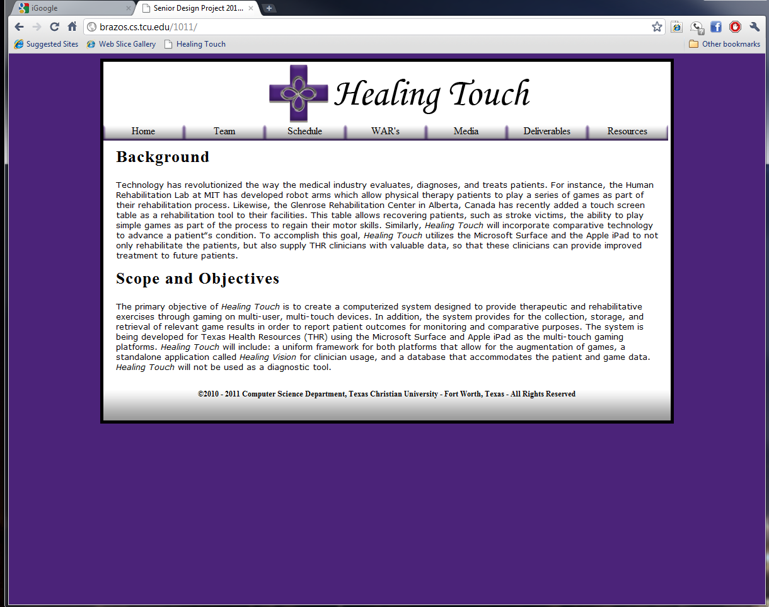
Project Website
Major Tabs
  Team
  Schedule
  WAR’s
  Media
  Deliverables
  Resources
Notes:
Matt

Slide 8
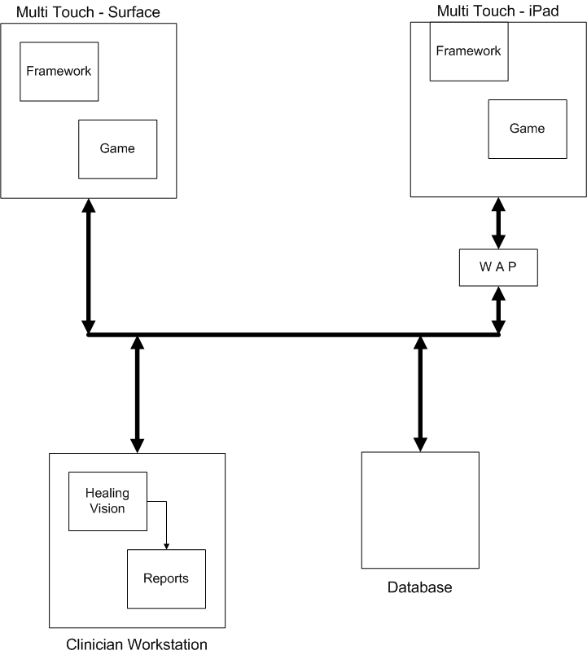
Healing Touch overview
Components
  Games
  Hardware
  Healing Vision
  Database
Notes:
Jeffrey N

Slide 9
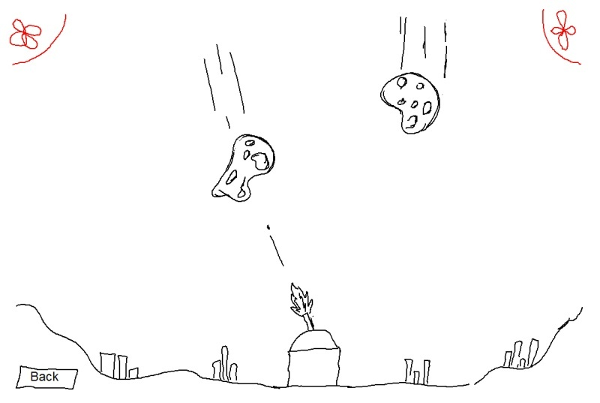
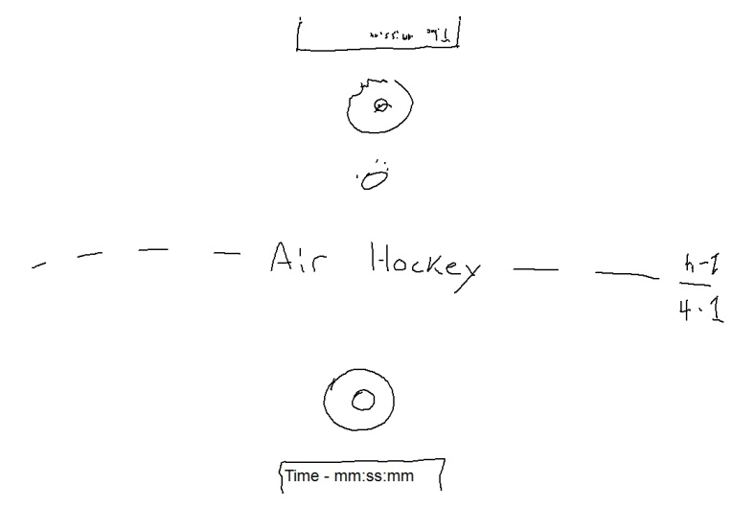
Healing Touch Games
Games focus on different aspects
  Neuromuscular – Maze, Meteors
  Memory – Froggie Says
  Deductive reasoning - Archery
  Social play – Air Hockey
Clinicians analyze game results and
monitor patient progress
Notes:
Michael

Slide 10
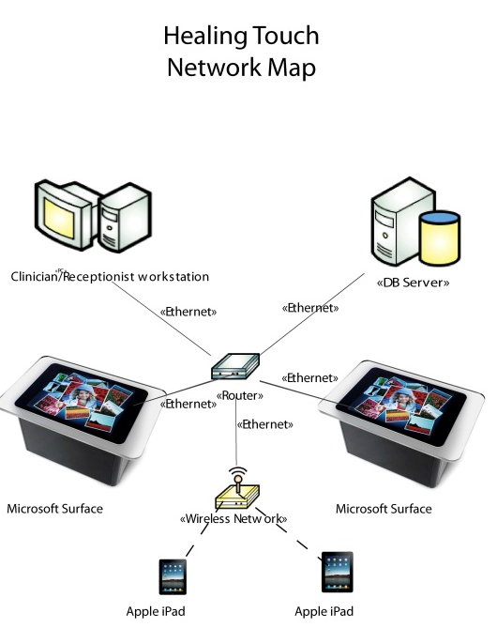
Hardware Overview
  Microsoft Surface
  Apple iPad
  Windows based workstation
  Windows based Server running SQL Server
Notes:
Anh

Slide 11
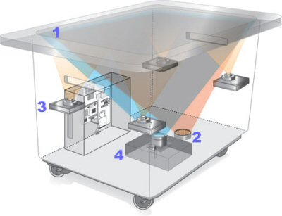
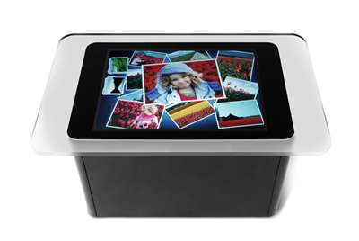
Microsoft Surface
Multi-user, multi-touch social interaction device.
Uses IR cameras to sense touches, capable of having 50+ active touch points
Intended to be used in a clinician’s office
Notes:
Alex

Slide 12
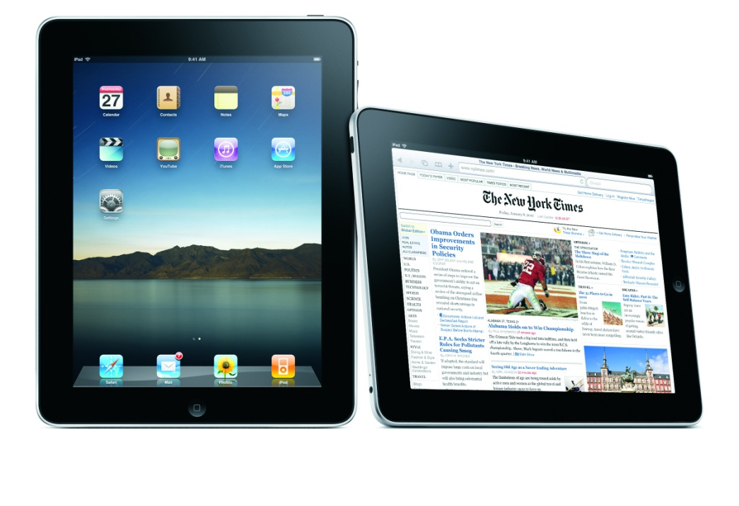
Apple iPAD
Multi-touch tablet
Up to 11 active touch points
take-home device for patients
Notes:
Anh

Slide 13
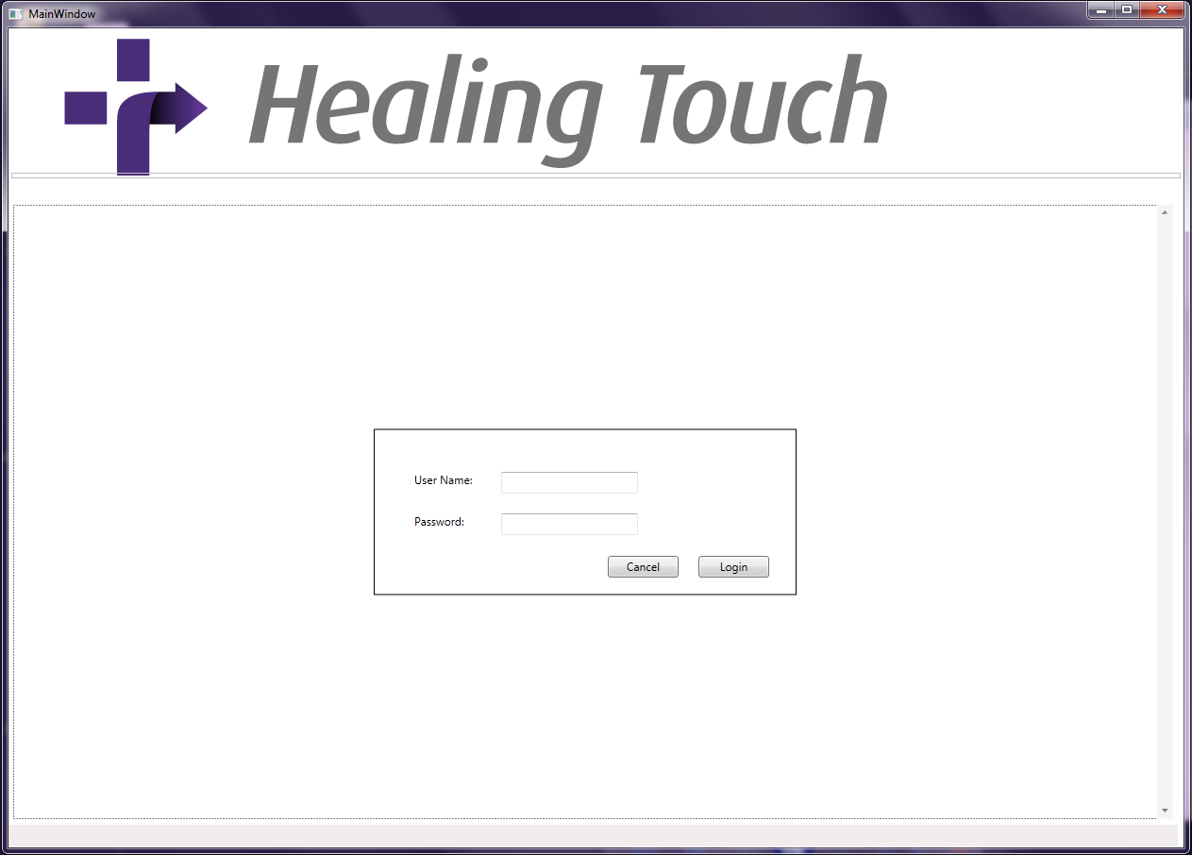
Healing vision overview
Features
  Add User
  Edit User
  Set Games Option of Each User
  Query Data
  Generate Reports
Notes:
Jeff R

Slide 14
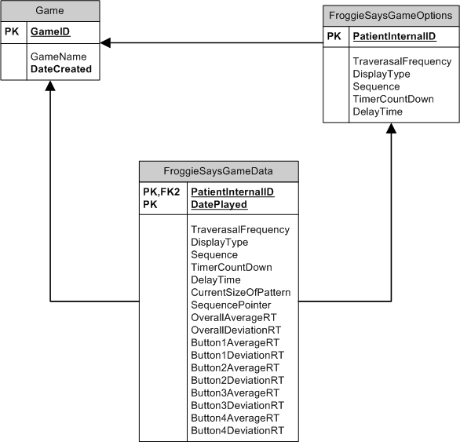
Database overview
Microsoft SQL 2008 R2
Notes:
Michael

Slide 15
Questions?
Notes:
Sean

Slide 16
Demos
1) “Froggie Says” on the Surface
2) “Froggie Says” on the iPad
3) Healing Vision
Notes:
Alex, Jeff N, Jeff R, Anh

